Slide 1
Projects 3 & 4: Classification Models, Clustering, ANN, and Text Mining
Tom Amir, An Lam, Jimmy Le, Min Li, Dianna Mendelez, Talal Jawaid, Amrit Singh

Slide 2
Introduction to Project 3: Classification
The name of this dataset is “Churn Rate.” It is the percentage of subscribers to a service who discontinue their subscriptions to the service within a given time period. For a company to expand its clientele, its growth rate, as measured by the number of new customers must exceed its churn rate
Figure out whether or not the person will EXIT(1), or NOT(0). This is based on the person's Credit Score, Region, Gender, Age, Tenure, Balance, and Salary.
Perform Pre-Processing techniques on the rest of the columns:
Split the data up into the standard 80/20 for the training data/testing data

Slide 3
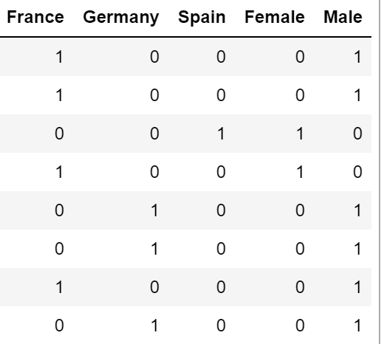
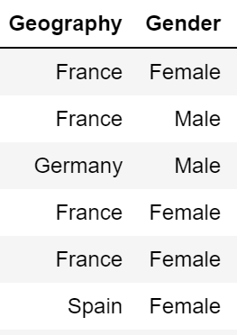
Preprocessing Project 3
Shuffling data serves the purpose of reducing variance
Normalizing the data is to reduce data redundancy
Drop useless columns: RowNumber, CustomerId, Surname
One Hot encoding is necessary because encoding features with a range of numbers does not make sense

Slide 4
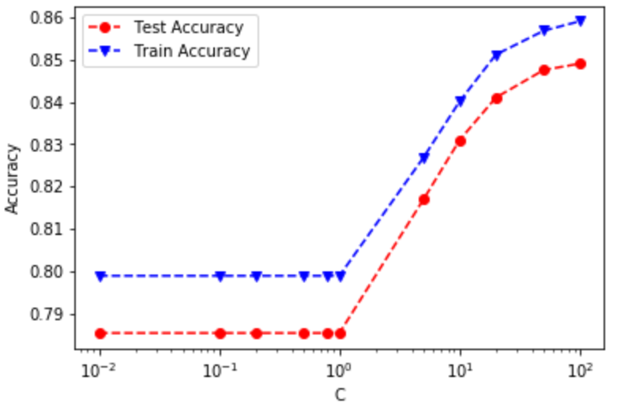
Support Vector Machines
Using Non Linear Decision Boundary
The larger the C value, the more time it needs to run
C = 100, accuracy: 85%

Slide 5
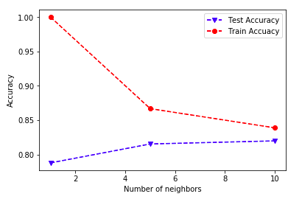
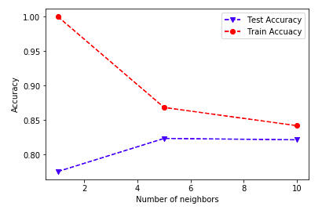
K - Nearest Neighbor
80 % Accuracy
Redundant variables (several in our data set) can affect accuracy
Before removal of Gender, Geography, HasCrCard
After removal of Gender, Geography, HasCrCard

Slide 6
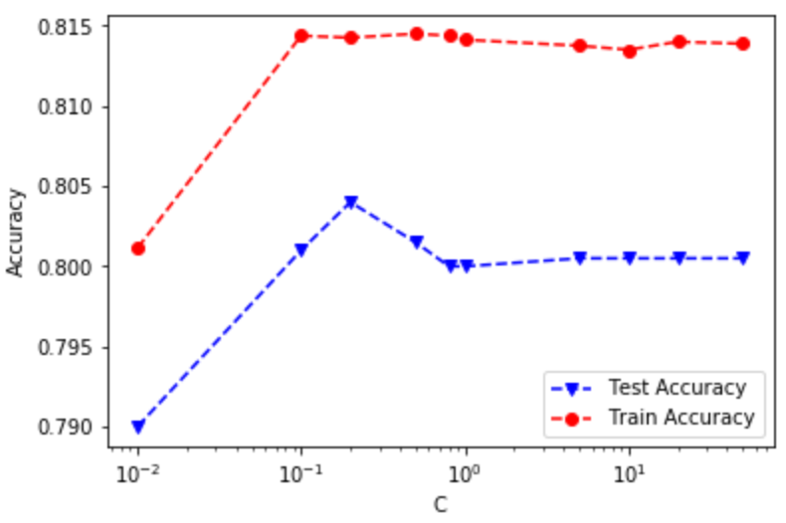
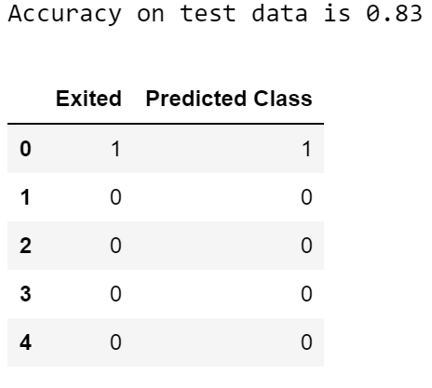
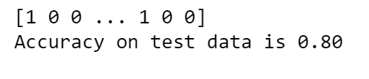
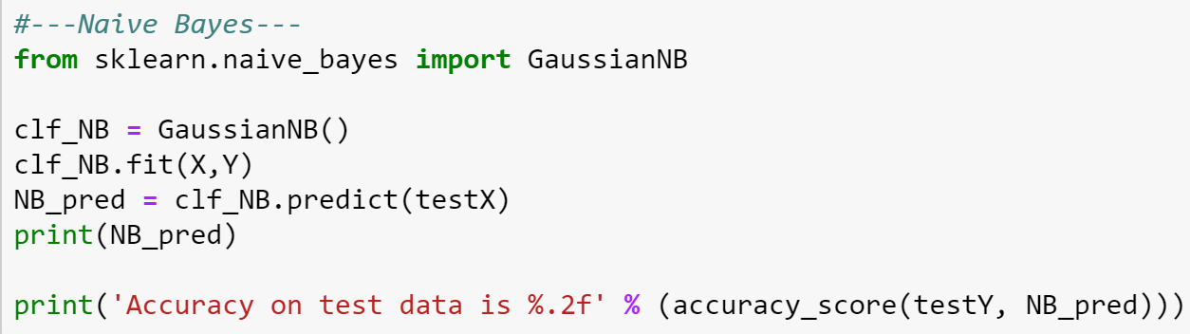
Logistic Regression
Decision Tree
Naive Bayes
Naive Bayes
Accuracy: 80%
Logistic Regression
C = 0.2, Accuracy: 80.4%
Decision Tree
Depth = 3, Accuracy: 83%

Slide 7
Introduction to Project 4
Cluster Analysis
Text Mining
Artificial Neural Network (ANN)

Slide 8
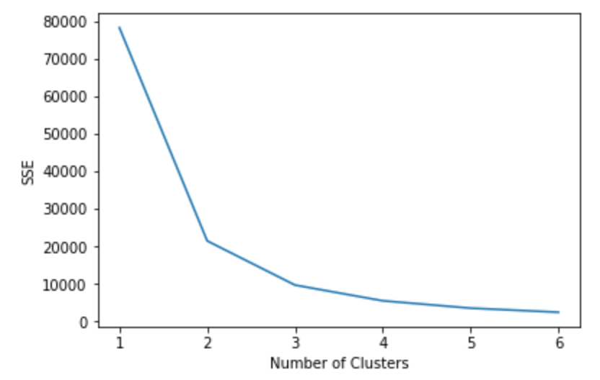
Part A: Clustering
Goal: To partition large data into meaningful sections
Applied K-Means clustering
Optimal cluster size based on Elbow Method: 3 clusters
Applied Hierarchical Clustering:
Single Link (Shortest Distance between clusters)
Complete Link (Longest Distance between clusters)
Group Average
Focused on movies with awards won (Best actor, best picture, etc.)
Used one-hot encoding

Slide 9
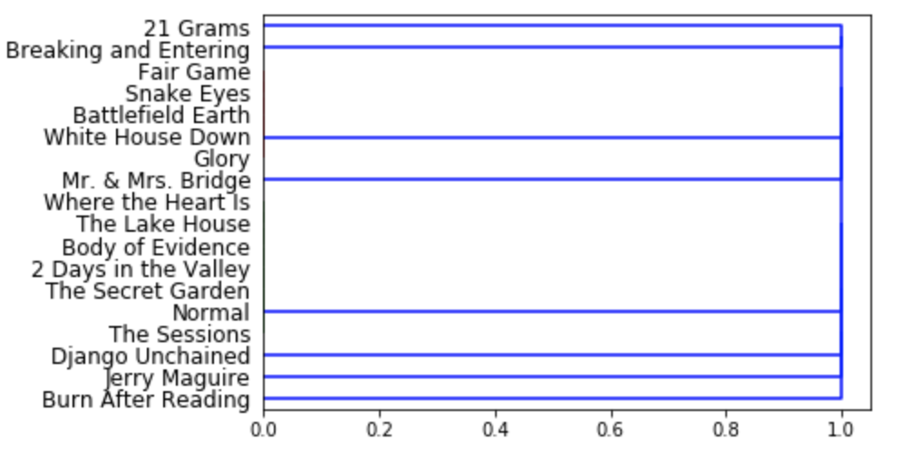
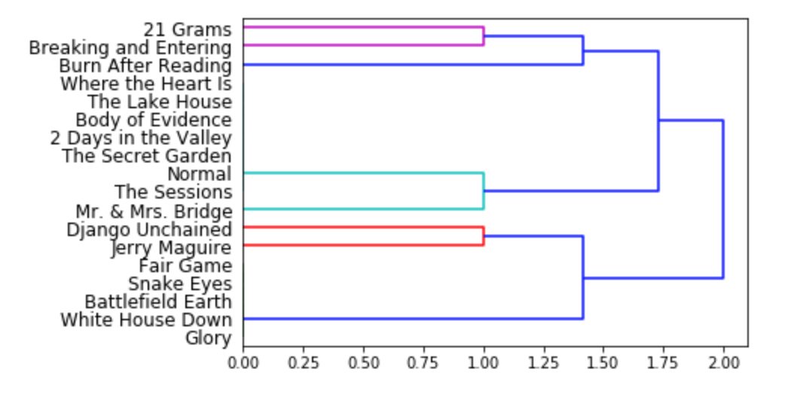
Single Link vs. Complete Link

Slide 10
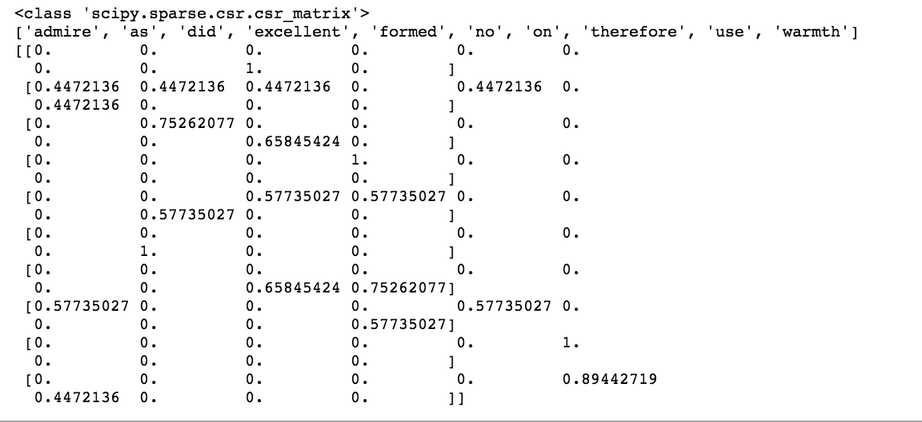
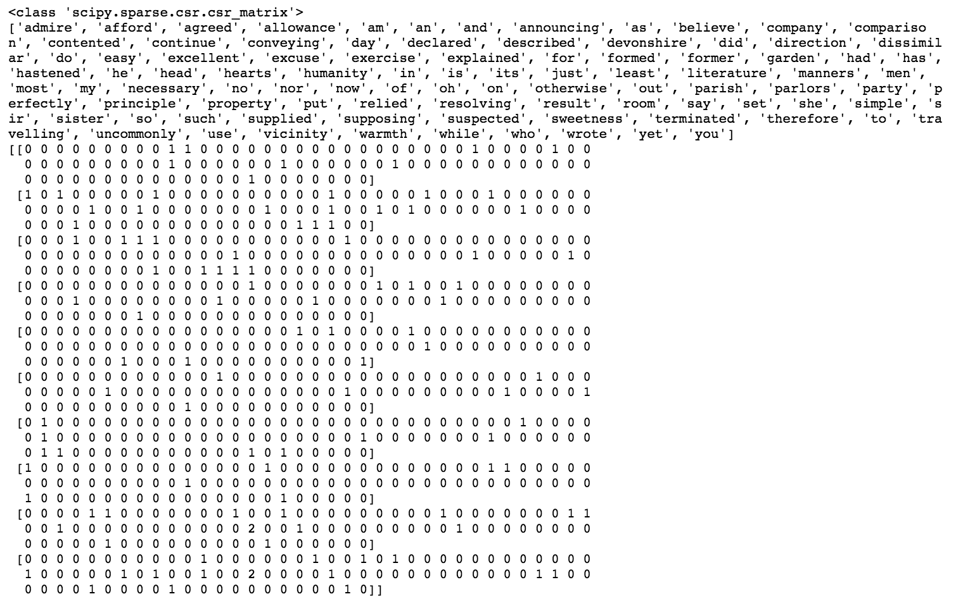
Part B: Text Mining
Given a dataset where it was Python list of text
CountVectorizer: Transfers text into sparse matrix which counts occurrences of words
TlidfVectorizer: Tf-dif values from the list of text
Tf-dif values are the significance of the word in a given document
Tfidf Vectorizer
Count Vectorizer

Slide 11
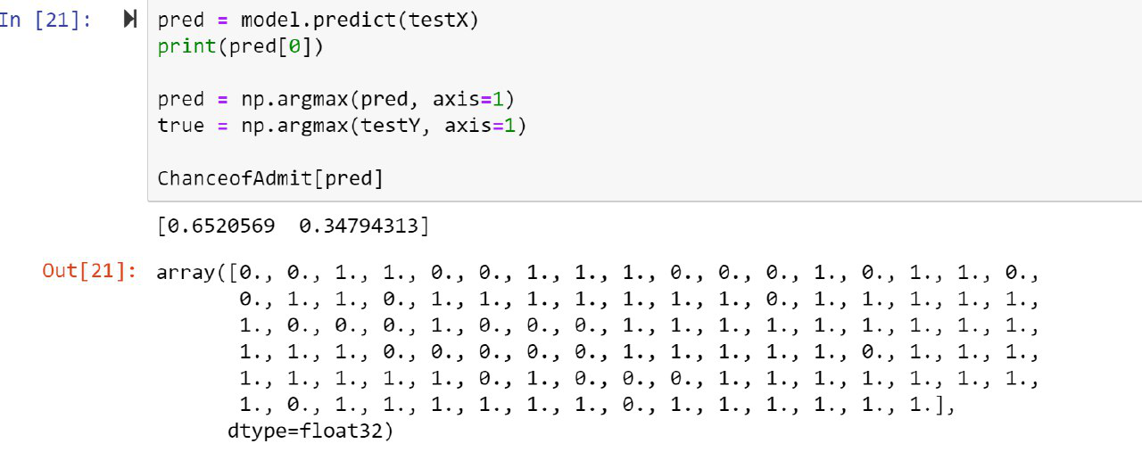
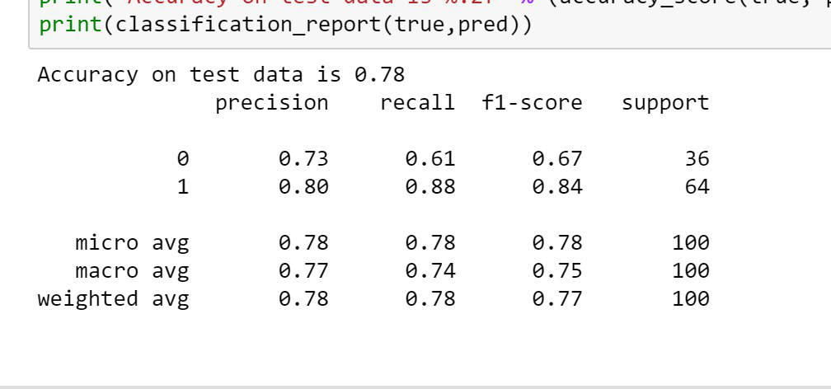
Part C: Artificial Neural Networking
Applied ANN on admission dataset using code given in tutorial 6
Yielded an accuracy of 78%

